Slide 1
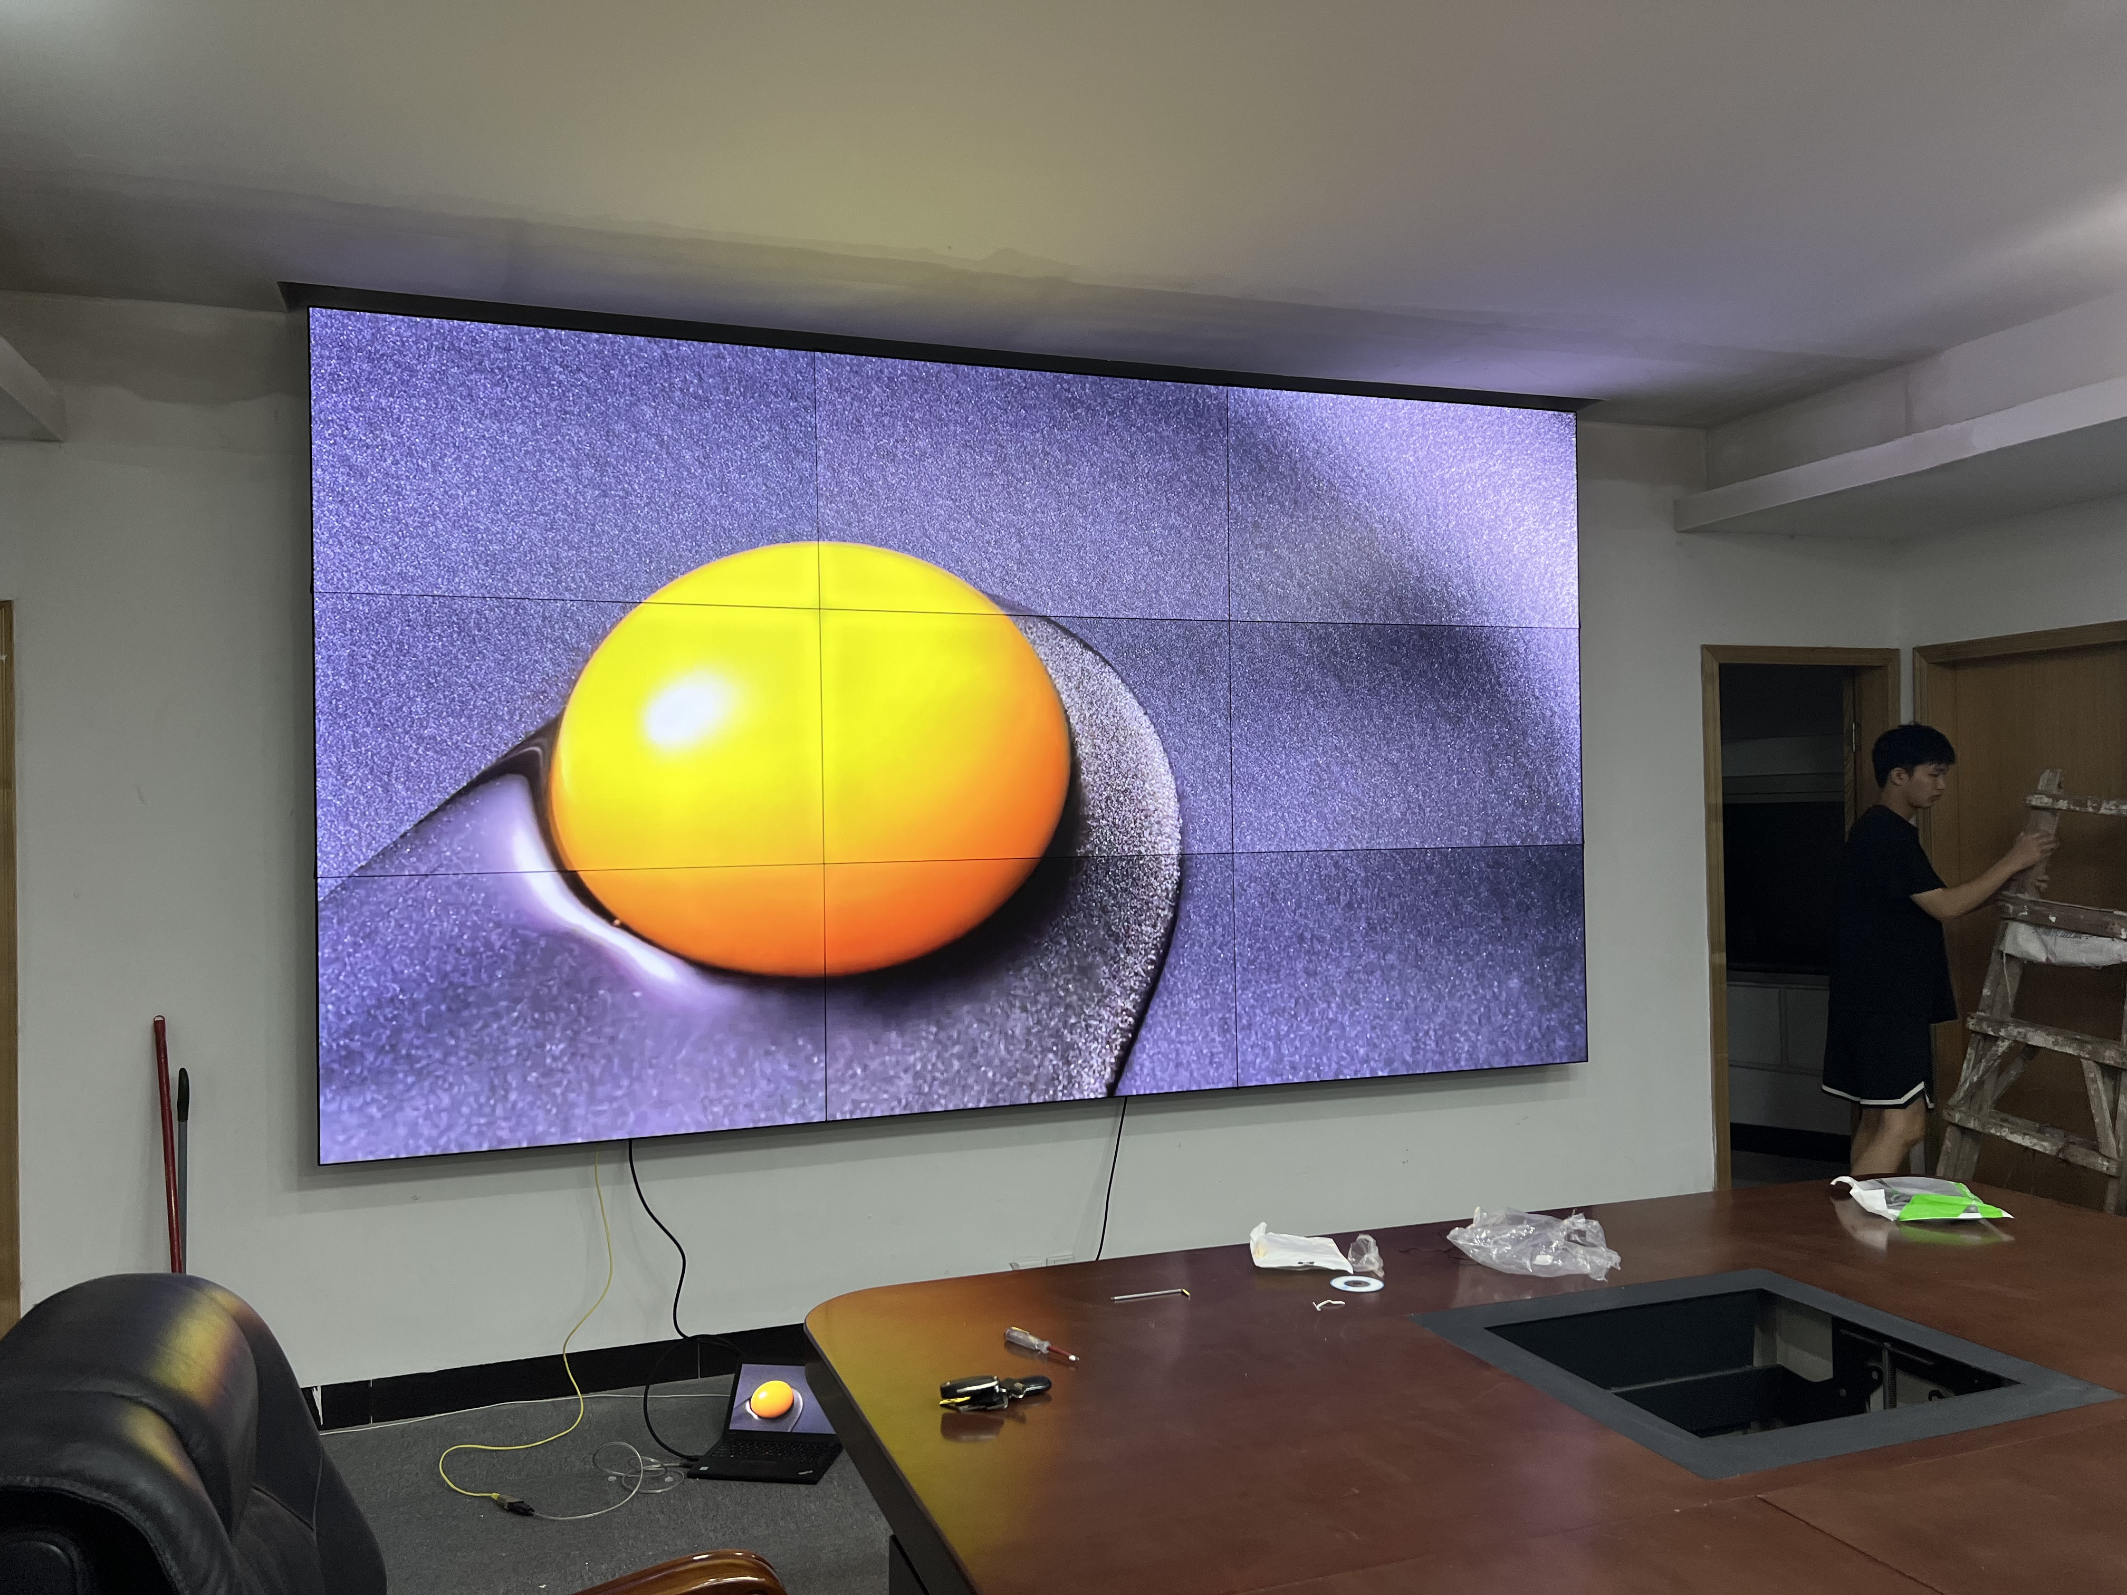
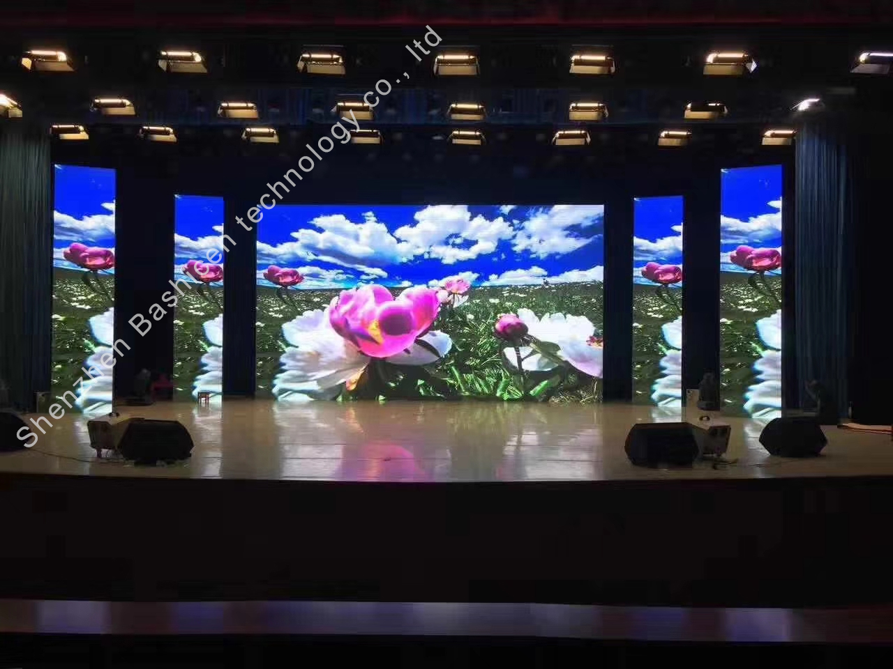
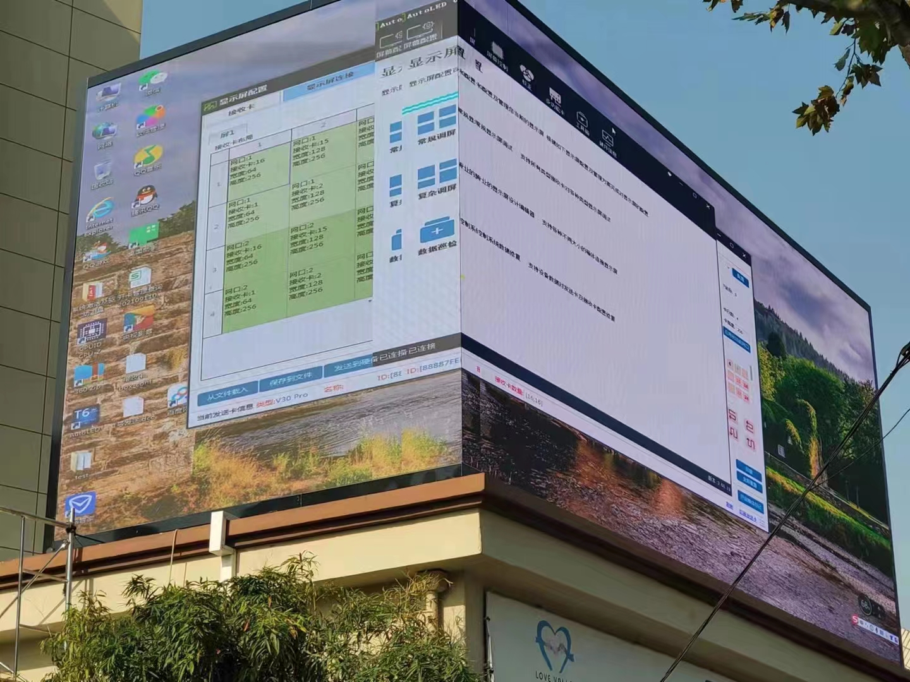
BAISHICEN
LED&LCD Manufacturer
LED&LCD DISPLAY CATALOG
Immersive experience display
with professional products
Further more information on LED&LCD Displays,
Please visit www.szbaisc.com
SHENZHEN BAISHICEN ELECTRONIC CO.,LTD
Address:402, Building A,1st Mashantou Park,Guang Ming, Shenzhen, 518107,China
Tel:+86 400 885 1938 Email: baisc168@qq.com
@2022 SHENZHEN BAISHICEN ELECTRONIC CO.,LTD All Rights Reserved.

Slide 2
01
Company Profile
02
Certificates
CONTANTS
03
LED Display
04
LCD Display

Slide 3
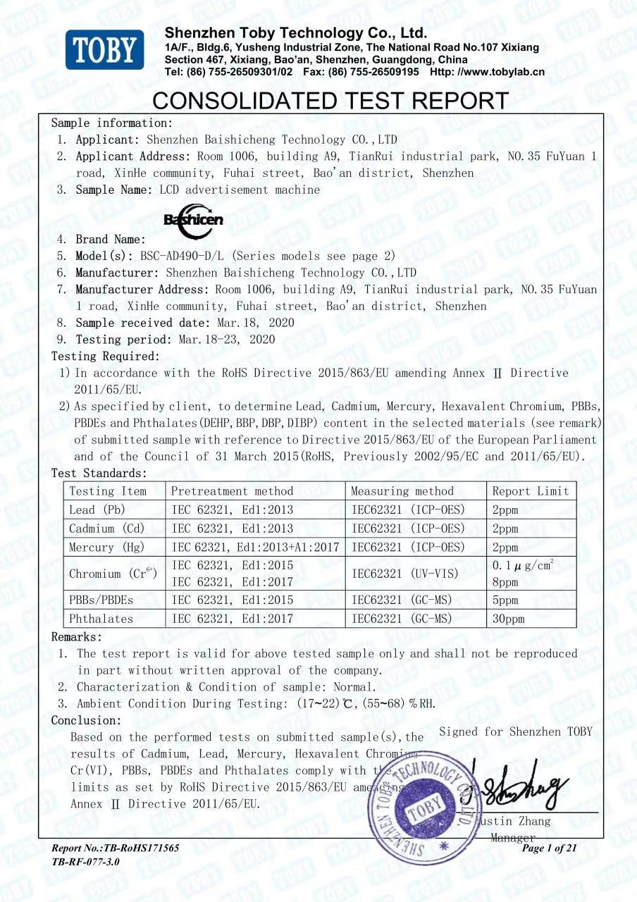
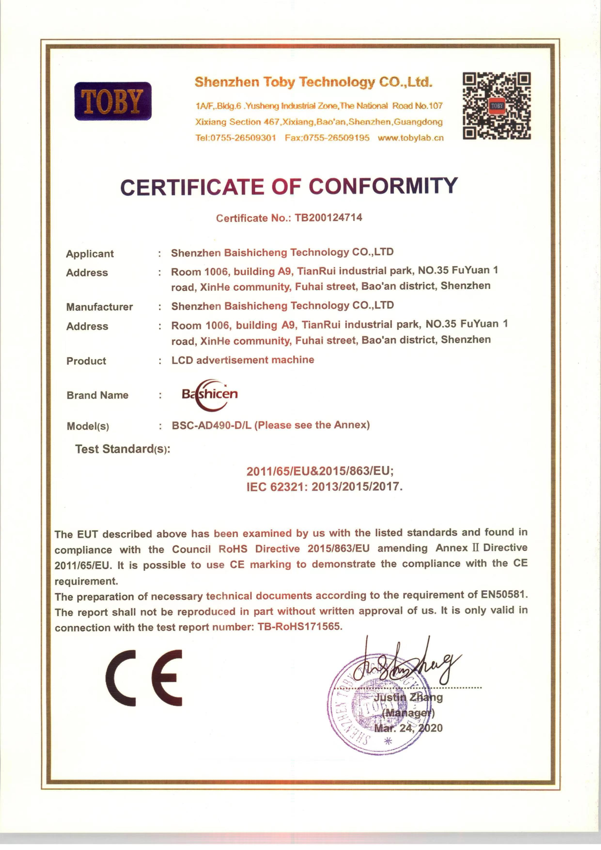
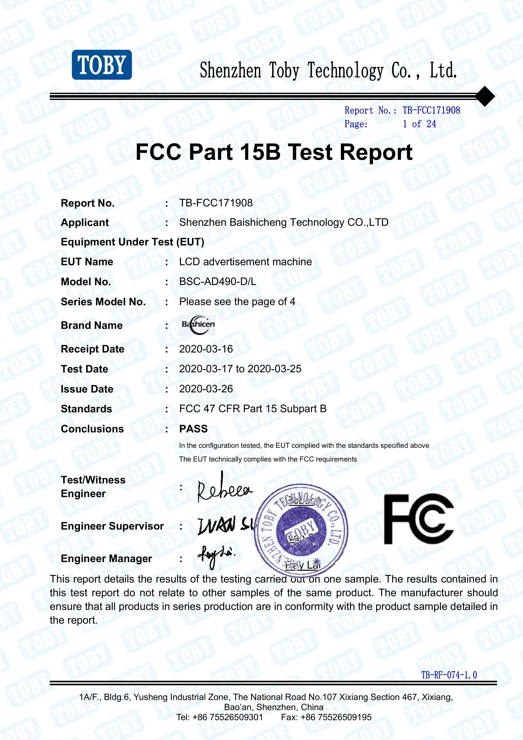
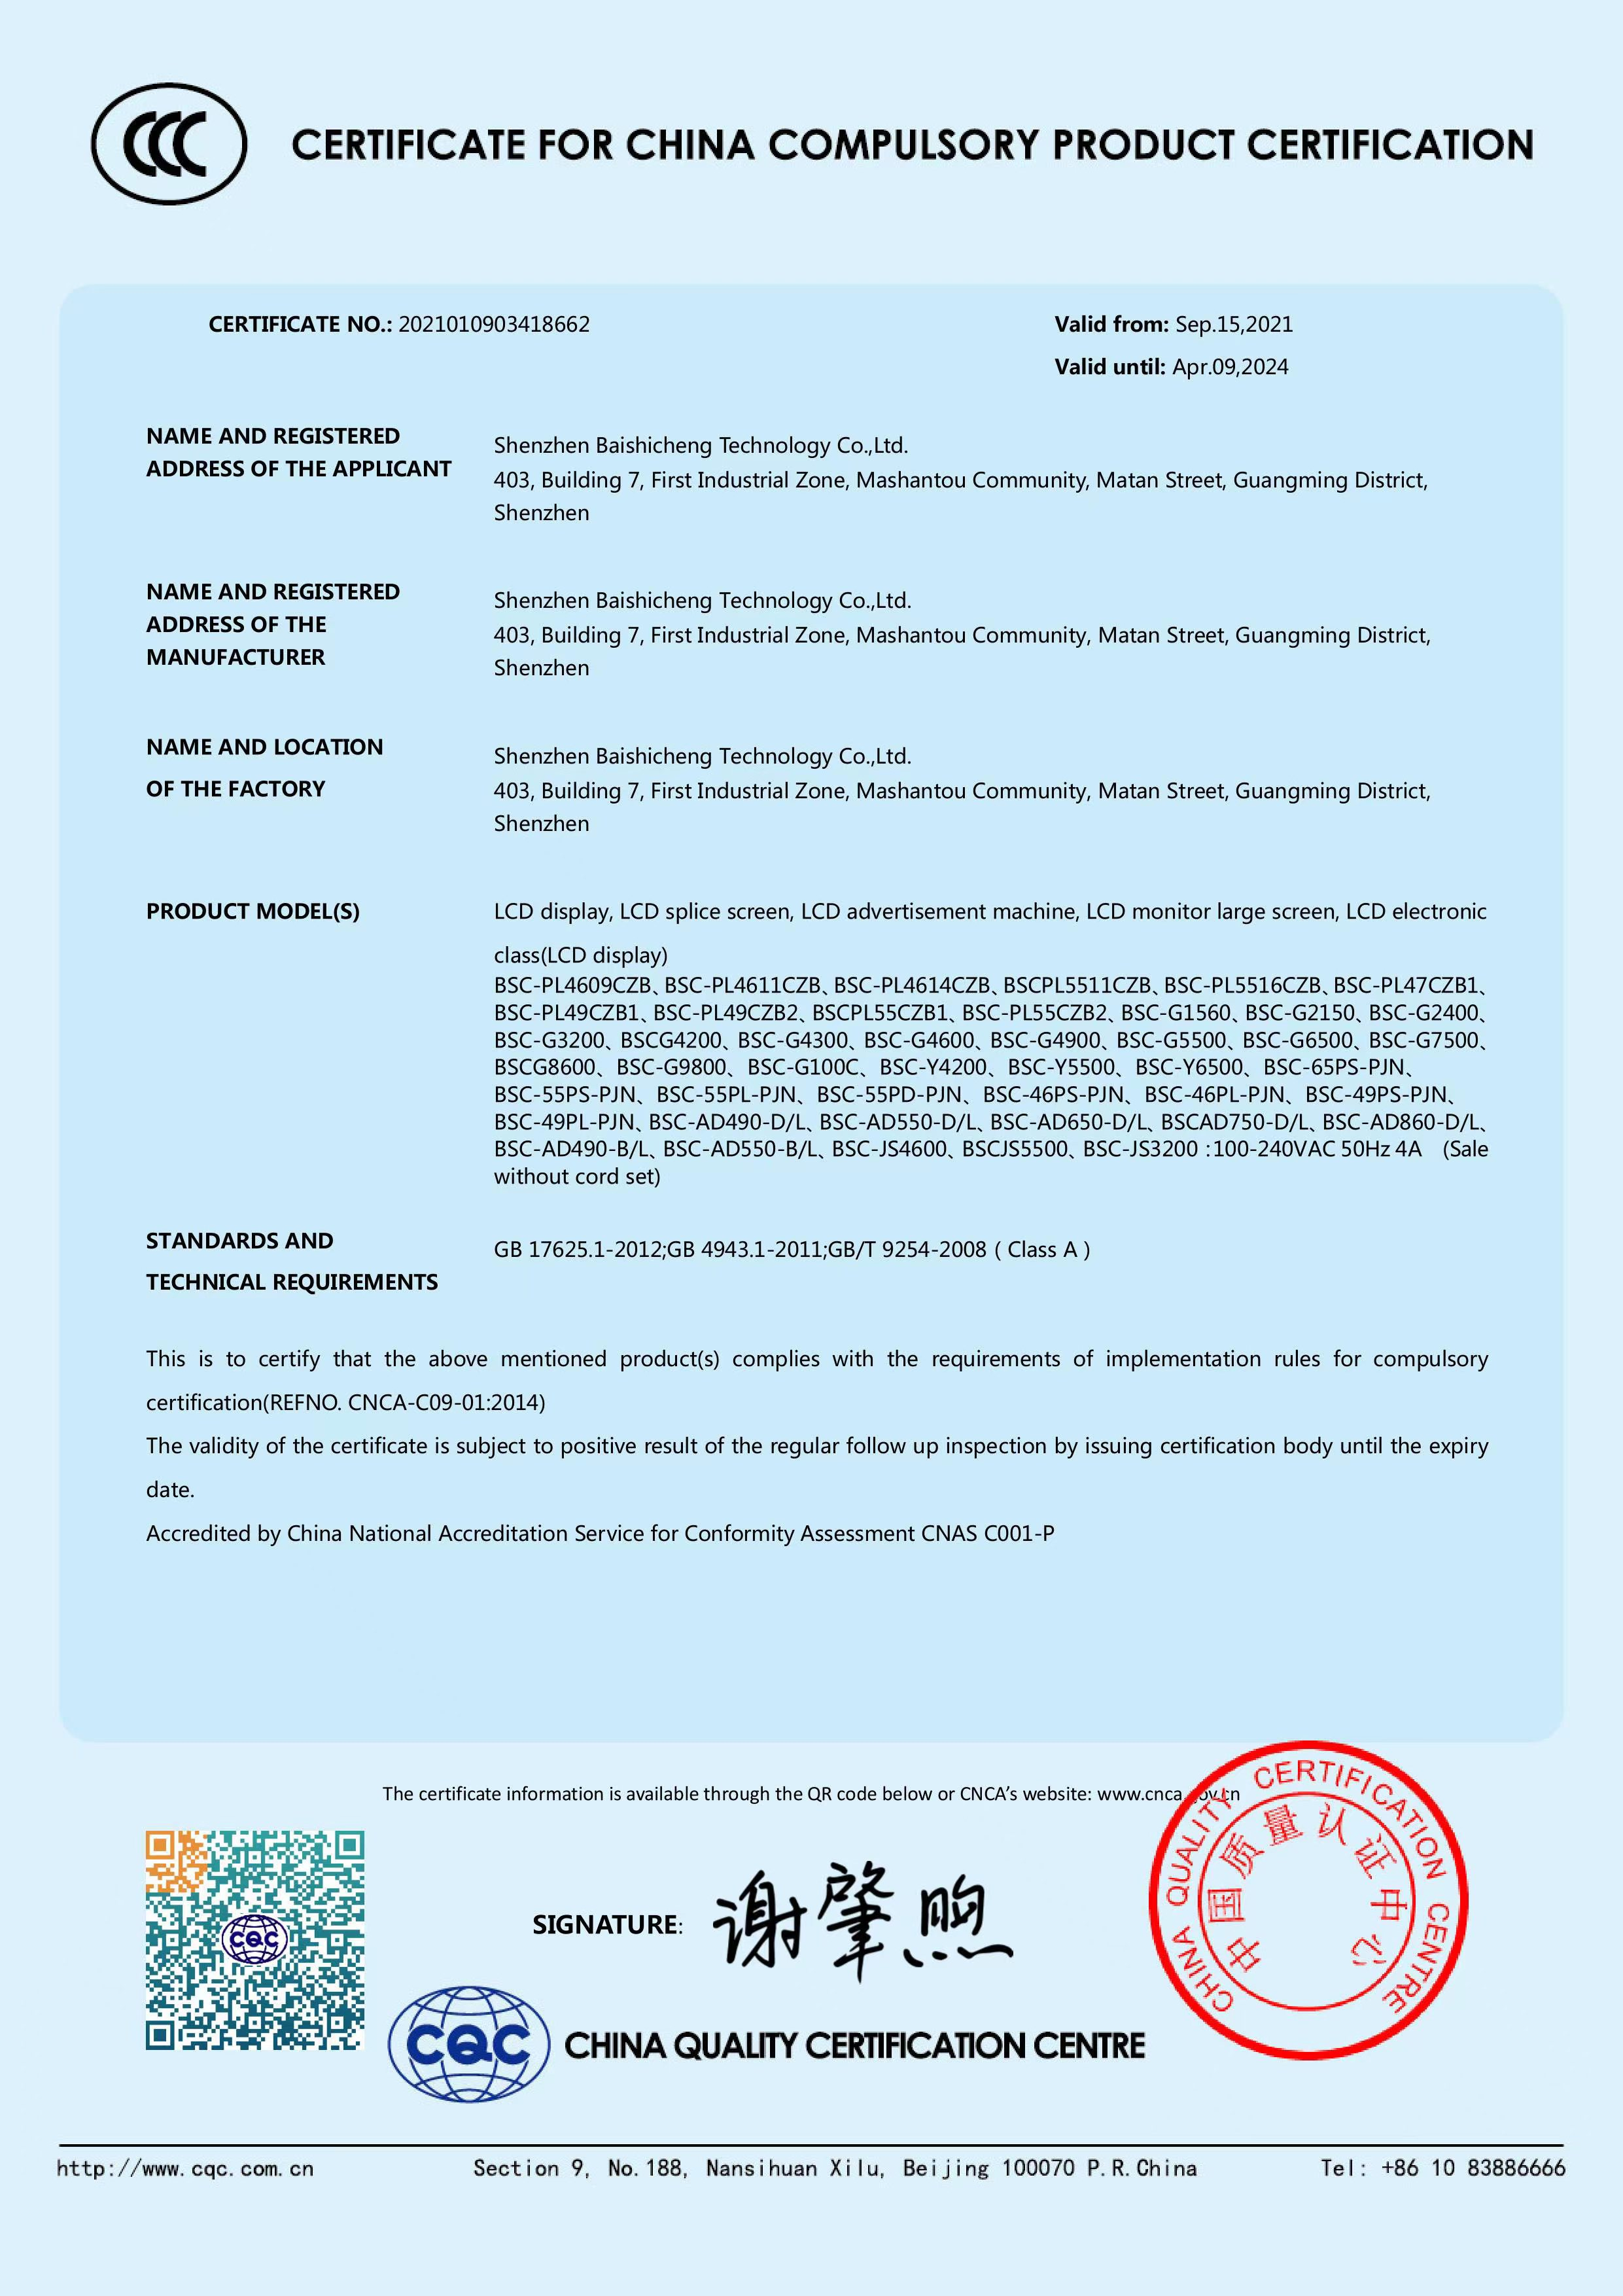
Company Profile
Introduction
We founded in 2014, BAISHICEN is a national standard global LED&LCD display manufacturer, located in Shenzhen, China. We produce integrative, intelligent and high-definition display, including LED&LCD.
Our good technical team provides sophisticated techniques with advanced equipment to ensure the very high quality with our products. Moreover, as a display manufacturer, the outstanding displays get the coginition with certificates of ISO9001, ISO14001, RoHS, CCC, FCC, TUV, BIS with a year free warranty.
BAISHICEN devote to offer clients prompt service and rapid delivery. We had worked with 20 more contries around the world, such as U.S, U.K, Singapore, Germany and so on.

Slide 4
BUSINESS AREA
Indoor LED Display(4K/HD/1080P)
Splicing LCD for different inch(55’’/49’’/46’’,ect.)
Outdoor LED Display(High Brightness Billborad)
LED&LCD
Sercurity Monitoring LCD
customized-available
Flexible LED Display(Bendable/DIY)
Commericial / Family Use HD LCD TV

Slide 5
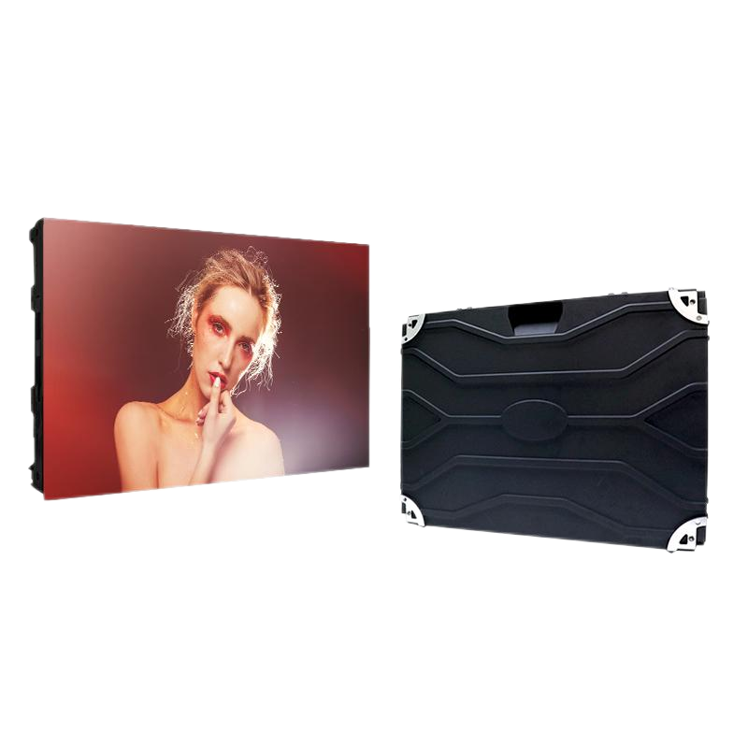
LED display plate products
HD Indoor LED Display
Pixels pitch(mm) | 0.9 |  | 1.25 | 1.538 | 1.667 | 1.839 | 2
Module Size(mm) | 300×168.75 | 320×160
Module resolution | 334×187 |  | 256×128 | 208×104 | 192×96 | 174×86 | 160×80
Cabinet size(mm) | 600x337.5 | 640×480
Cabinet resolution | 667x375 |  | 512x384 | 416x312 | 384x288 | 348x262 | 320x240
Cabinet weight(kg) | 7.5
Pixel density (pixel/m2) | 1337777 |  | 640000 | 422750 | 360000 | 295664 | 250000
Viewing Angle | Horizontal 140°; Vertical 140°
Brightness(cd/m²) | 600
Working Voltage | AC110 / AC220V±10% 47～63HZ
Power Consump (Max/sqm) | 800
Power Consump (Ave/sqm) | 350
Refresh frequency(Hz) | 3840
Life | ≥60000H
1. Dynamic sanning with stable image,
won't flicking and without ripples.
2. All form of information can be displayed
(picture, video, animation,etc.)
3. Easily installation and maintenance.
4. High refresh frequency and remote control are supported.

Slide 6
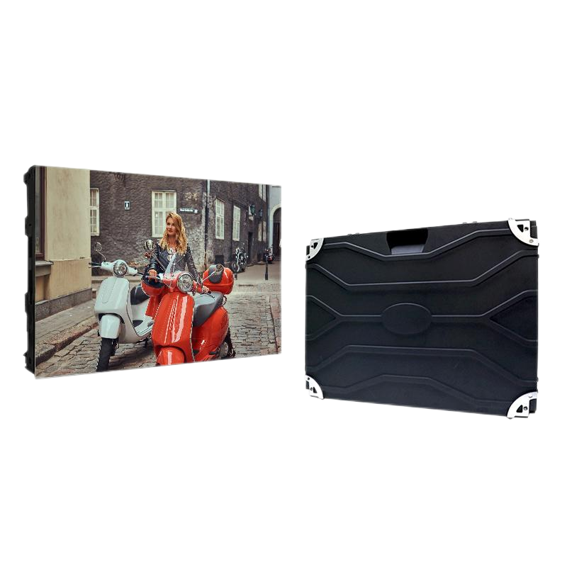
LED display plate products
Conventional LED Display
Pixel pitch(mm) | 2 | 2.5 | 3 | 4 | 5 | 6
Module size(mm) | 320×160 | 320×160 | 192×192 | 256×256 | 320×160 | 192×192
Module resolution | 160×80 | 128×64 | 64×64 | 64×64 | 64×32 | 32×32
Cabinet size(mm) | 640x480 | 640x480 | 576x576 | 512x512 | 640x480 | 576x576
Cabinet resolution | 320x240 | 256×192 | 192x192 | 128x128 | 128x128 | 96x96
Cabinet weight(kg) | 7.5 | 7.5 | 12 | 11 | 11 | 11
Pixel density (pixel/m2) | 250000 | 160000 | 111111 | 62500 | 40000 | 277777
Viewing Angle | Horizontal 160°; Vertical 140°
Brightness(cd/m²) | 600
Working Voltage | AC110 / AC220V±10% 47～63HZ
Power Consump (Max/sqm) | 800
Power Consump (Ave/sqm) | 350
Refresh frequency(Hz) | 3840 | 1920 | 1920 | 1920 | 1920 | 1920
Life | ≥60000H
1. Dynamic sanning with stable image,
won't flicking and without ripples.
2. All form of information can be displayed
(picture, video, animation,etc.)
3. Easily installation and maintenance.
4. Remote control is supported.

Slide 7
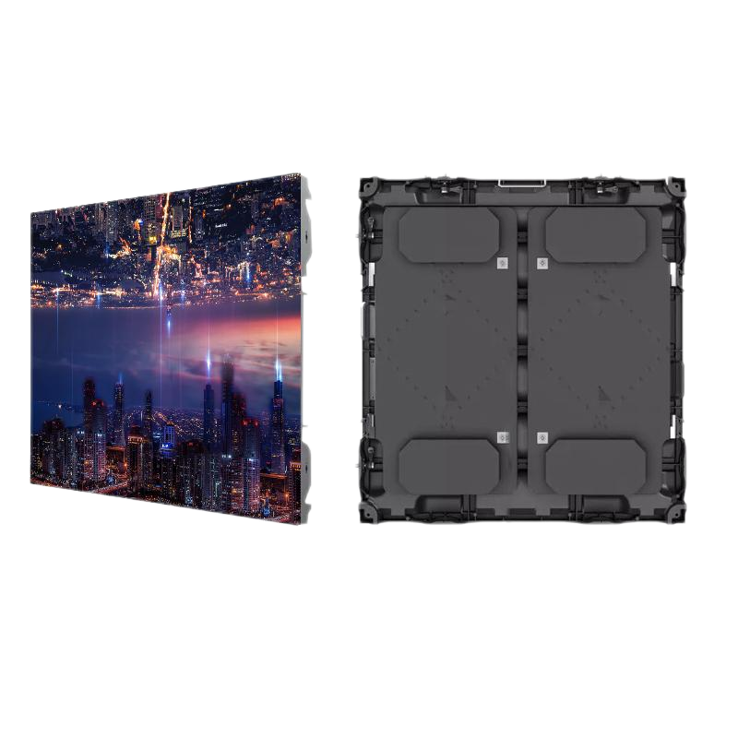
LED display plate products
Coventional Outdoor Series
Pixel pitch(mm) | P2.5 | P3 | P4 | P5 | P6 | P8 | P10 | P16
Module size(mm) | 320×160
Module resolution | 128×64 | 64×64 | 64×64 | 64×64 | 32×32 | 40×20 | 32×16 | 20×10
Cabinet size(mm) | 960×960
Cabinet resolution | 192×192 | 192×192 | 128×128 | 128×128 | 96×96 | 120×120 | 96×96 | 60×60
Cabinet weight(kg) | 25
Viewing Angle | Horizontal 160°; Vertical 140°
Brightness(cd/m²) | ≥5000
Color | Full color
Refresh frequency(Hz) | 1920 or 3840
Pixel density (pixel/m2) | 160000 | 111111 | 62500 | 40000 | 27777 | 15625 | 10000 | 5400
Working Voltage | AC110 / AC220V±10% 47～63HZ
Power consumption | Max: 468W/m² ; Ave:156W/m²
Life | ≥60000H
1. Dynamic sanning with stable image,
won't flicking and without ripples.
2. All form of information can be displayed
(picture, video, animation,etc.)
3. Easily installation and maintenance.
4. High Brightness and remote control
are supported.

Slide 8
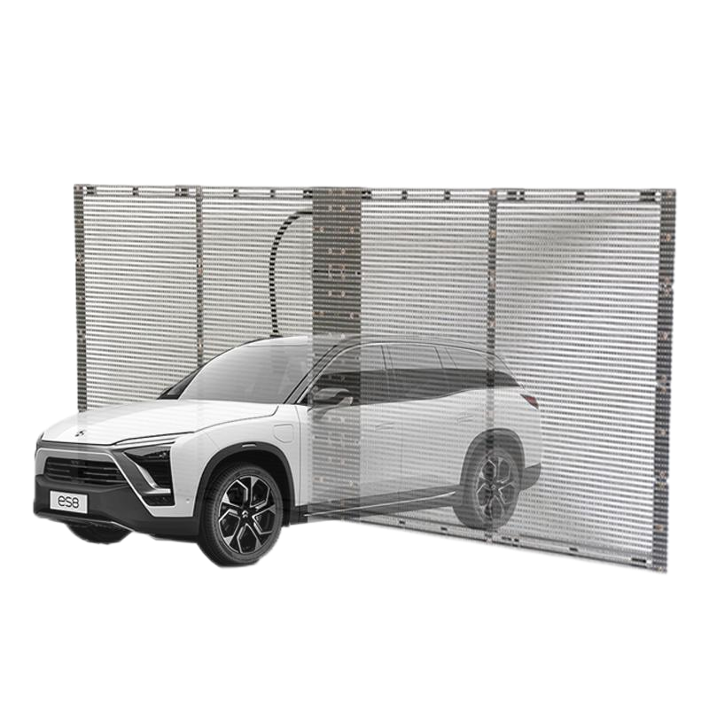
LED display plate products
Transparent screen series
Model | BSG T10.4 | BSC T3 | BSC T7
Pixel configuration | SMD3535 | SMD2121 | SMD2121
Pixel density (pixel/m2) | 9216 | 32768 | 8192
Brightness(cd/m²) | 2500
Cabinet weight(kg) | 7
Permeability | 75% | 55% | 65%
Brightness(cd/m²) | ≥4500nit | ≥3000nit | ≥5000nit
Refresh frequency(Hz) | ≥1920Hz
Driving method | 1/3S | 1/8S | 1/4S
Power Consump (Max/sqm) | 400W/m²
Power Consump (Ave/sqm) | 180W/m² | 150W/m² | 180W/m²
Protective Grade | IP43
1. Transparent and high color contrast ratio.
2. Easily installation and maintenance.
3. Customized available.
4. Energy conservation and environment protection.

Slide 9
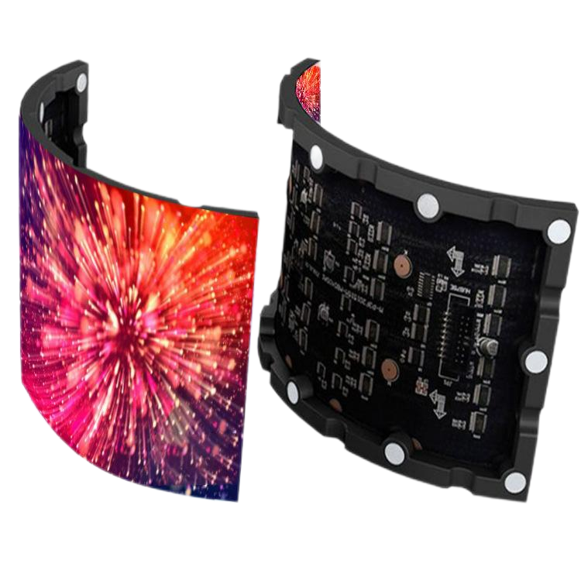
LED display plate products
Indoor Flexible LED Display
1. Ultral-thin frame, 8.6mm module thickness.
2. Flexible 120° bendable radian.
3. Magnet installation method, cost-effective.
Product Name | P1.875 | P1.923 | P2 | P2 | P2.5 | P2.5 | P2.6 | P3 | P4 | P5
Pixel spacing(mm) | 1.873 | 1.923 | 2 | 2 | 2.5 | 2.5 | 2.6 | 3 | 4 | 5
Pixels | SMD1515 (1R1G1B) | SMD1515 (1R1G1B) | SMD1515 (1R1G1B) | SMD1515 (1R1G1B) | SMD2121 (1R1G1B) | SMD2121 (1R1G1B) | SMD2121 (1R1G1B) | SMD2121 (1R1G1B) | SMD2121 (1R1G1B) | SMD2121 (1R1G1B)
Module size(mm) | 240*120 | 200*150 | 240*120 | 256*128 | 240*120 | 320*160 | 250*1285 | 240*120 | 240*120 | 320*160
Module resolution | 128*64 | 104*78 | 120*60 | 128*64 | 98*48 | 128*64 | 96*48 | 80*40 | 60*30 | 64*32
Angle | H.160N 140°
Brightness | ≥5000
Color | Full color
Brightness level | 500-700nits
The refresh rate(Hz) | ≤2800Hz
Unit pixels per inch | 8192pixeis | 8112pixeis | 7200pixeis | 8192pixeis | 4608pixeis | 8192pixeis | 4608pixeis | 3200pixeis | 1800pixeis | 2048pixeis
Life | ≥60000H
Working Voltage | 220VAC50-60Hz

Slide 10
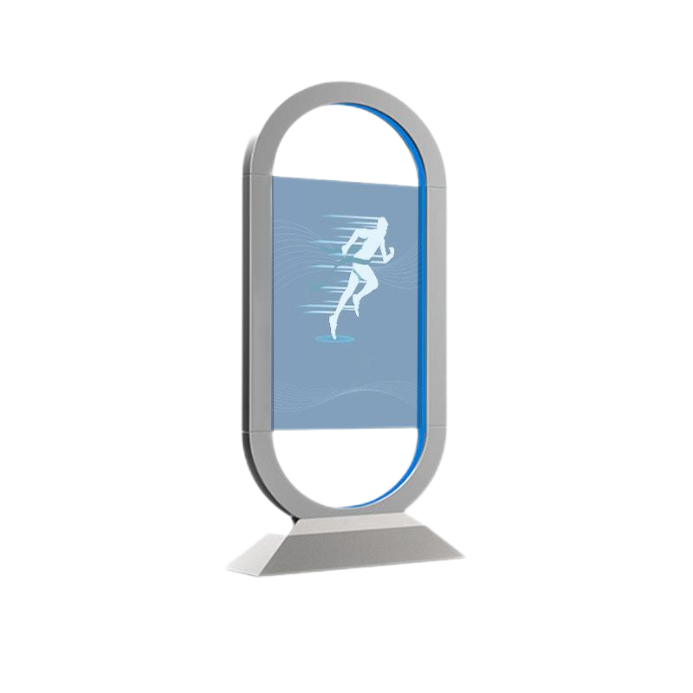
OLED display plate products
Transparent Oled advertising screen
Parameter name | BSC-5501-D | Lamp type | Autoluminescence
Display screen size | 5 inches (16:9) | Surface treatment | Hard coating（2H）
Display screen type | 2KOLED OLED screen, AM-OLED | Touch screen | Capacitive/infrared touch
Screen display size | 1609（H）x680(V) | Optional interface of whole machine | USB HDMI DP DVI
The physical resolution | 1920（H）x1080（V） | Whole machine power supply | 220V
Display color | 1.078,100%sRGB | Operating temperature of applicatio environment | 0～50℃
Frame frequency | 120HZ | Splicing physical jointing | 12mm
Brightness | 150～400 cd/m² | Refresh rate | ≥1920HZ
Contrast | 10000: 1 (typ.) (transmission) | The protection grades | interior
Angle of view (degree) | 60/60/60/60（Min） | Transparency | 65%
Aspect ratio | 16:09 | Pixel composition | SMD1921 lamp
Response time | 8（Typ.）(G to G)ms | Operating voltage | DC5-3.5V/AC85-240V
Support color | 1.078,100%sRGB | Life | 30K
Product size | 1235mmx703.4mm
1. Pixel self-help light control, ultra-high light transmittance
2. OLED panel with a thickness of only 3mm
Industrial narrow edge design
3. No light absorption, reproduction of pure black and
Super contrast
4. When playing graphic content, you can also watch the real scene behind the screen at the same time..

Slide 11
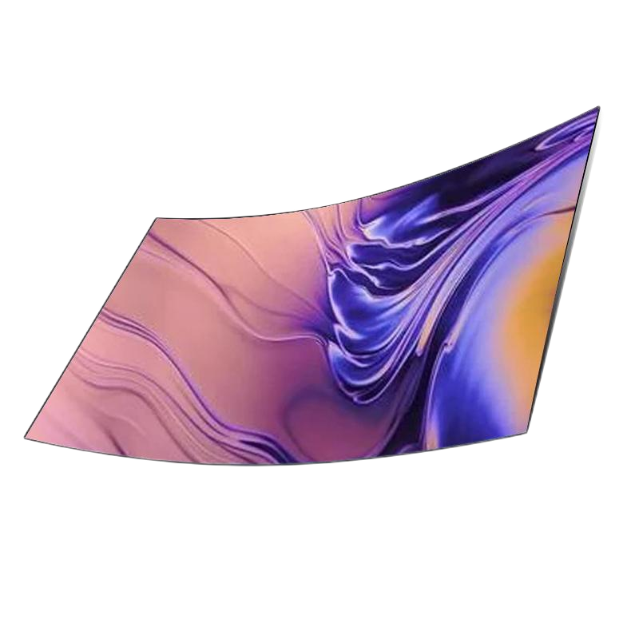
OLED display plate products
Oled curved splicing screen
1. It has expandable and flexible performance, which can adapt to the requirements of different space sizes and shapes.
2. Multiple monitors of a splicing module can display different pictures separately.
3. Accurate and stable color reproduction, and self-luminous pixels restore colors with extremely high accuracy.
Parameter name | BSC-Q5500 | The dynamic contrast | 100000:1.
Display size | 55 inch | The refresh rate | 120 hz
Typical value | 190 w. | The screen resolution | 1920 * 1080
DPM | 3W | Color gamut | 108%
Switch anelectrical device off | 0.5 W. | Viewing Angle | 178 °
Brightness | 150 ~ 400 CD/m squared | The input voltage | AC100-240 - v
Display scale | 16:09 | Life | 30000 hours
Input interface | HDMI * 2 * 1 DP interface | Valid Display range | 1209.6 (H) x 680.4 (V)
Pixel number | 6220800 | Backlight type | OLED self - emitting
Panel size | 1218 x694mm | The Power consumption | < 250 w

Slide 12
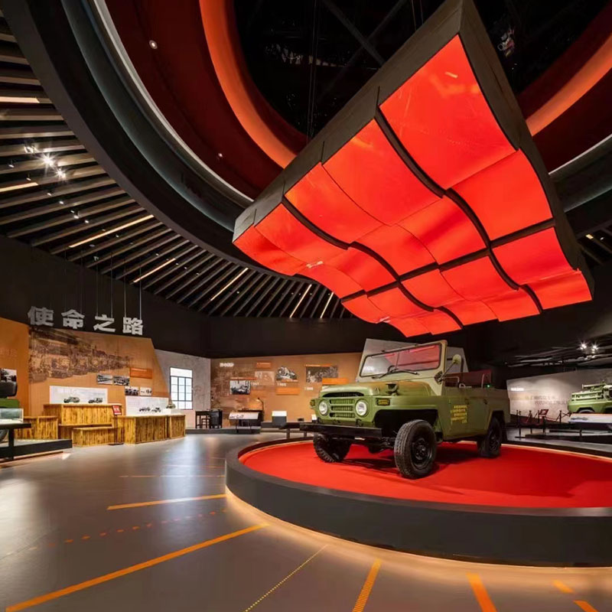
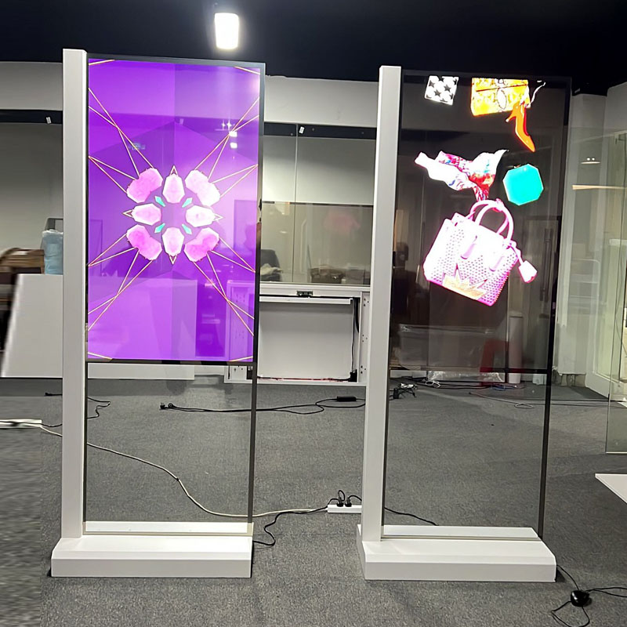
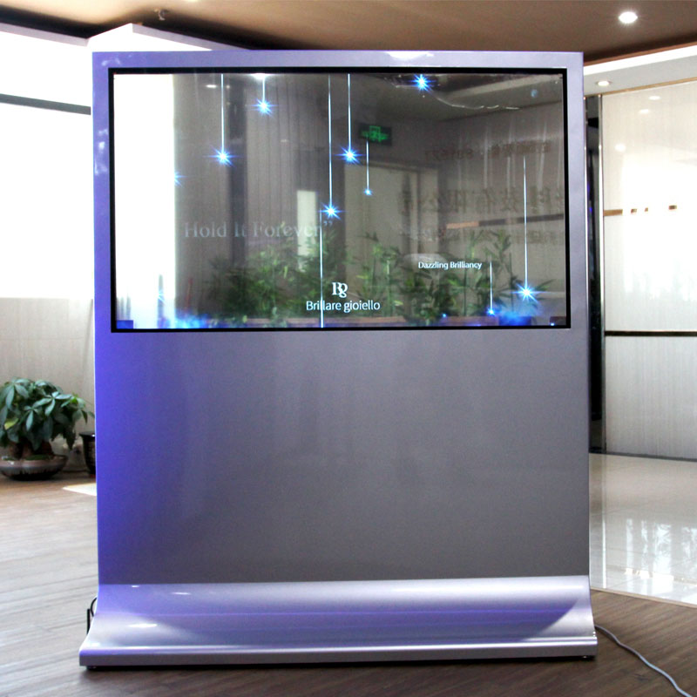
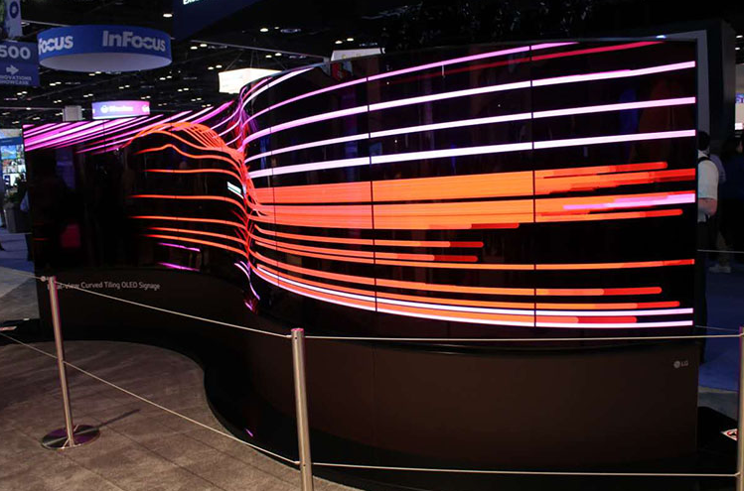
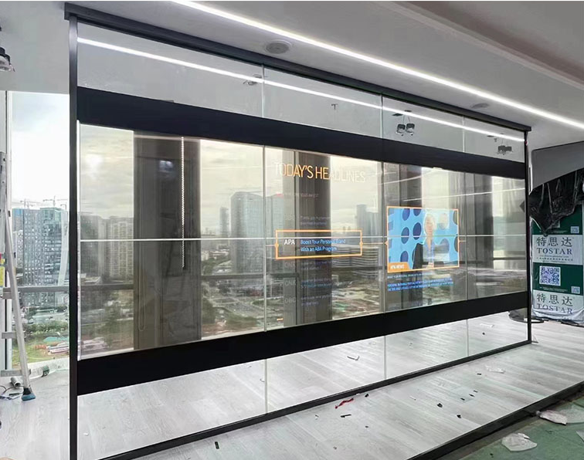
Series of OLED cases

Slide 13
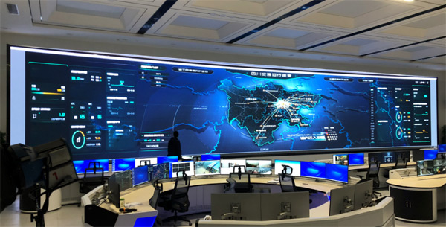
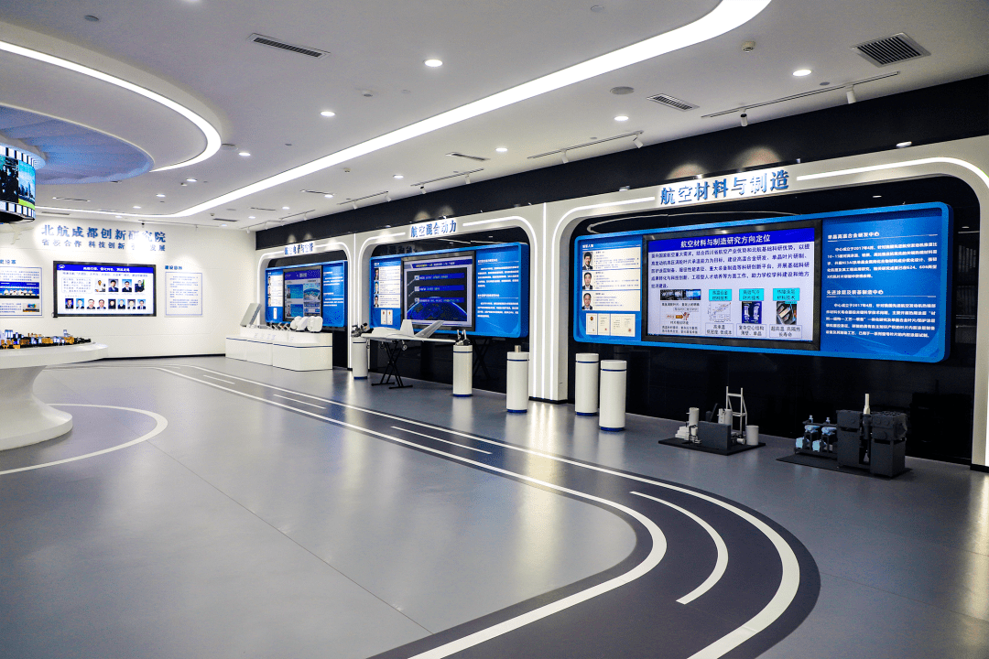
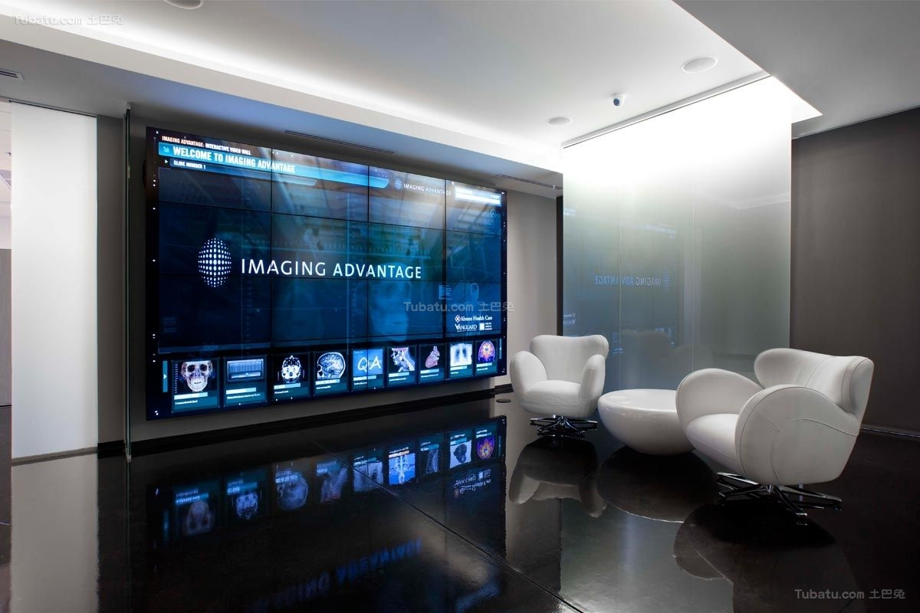
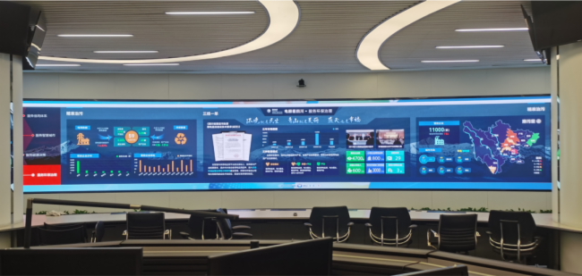
Security Monitor Case Pictures
1
2
3
4

Slide 14
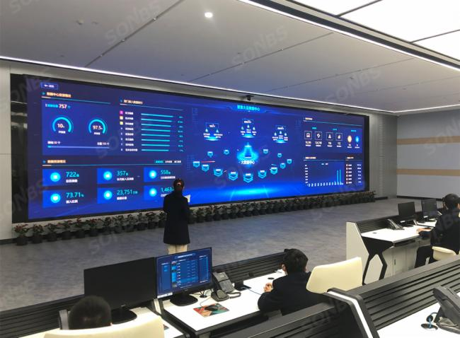
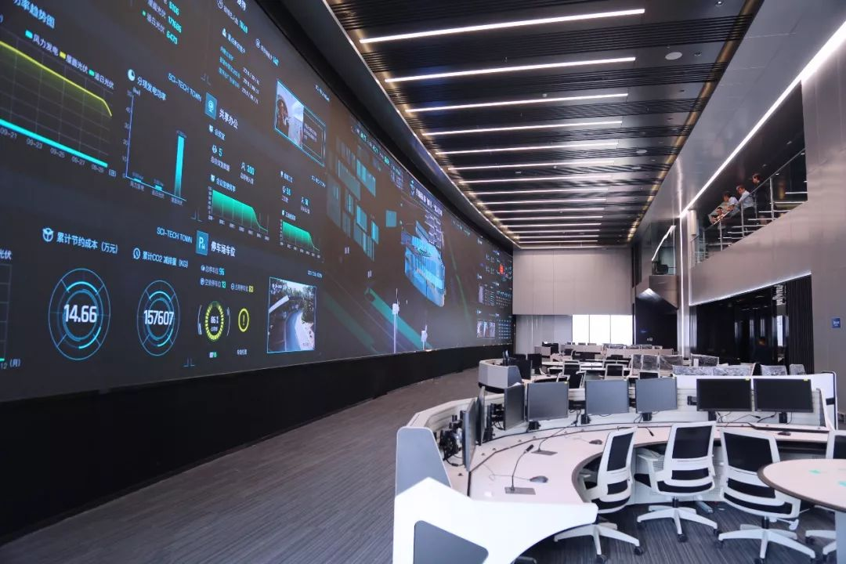
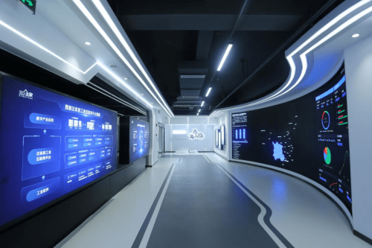
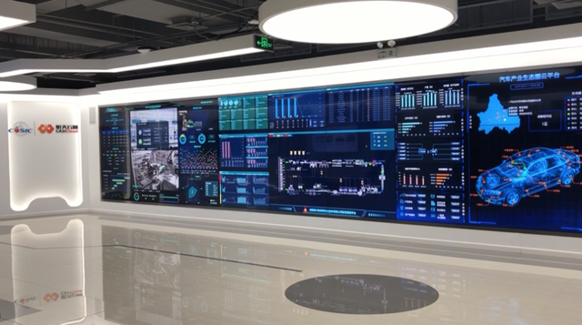
Security Monitor Case Pictures
5
6
7
1. 60sqm Data Centers in Bangladesh
2. 40sqm HD LED Display for Command
Center in Hubei.
3.80sqm Company Command Center in
Costto.
4. 125sqm Monitor Display for Public Security
Bureau in Shandong.
5. 40sqm Command Platform for Indoor LED.
6. 74sqm Display for Environmental
Emergency Center
7. 64sqm Hospital 4K LED Display
8. 86sqm Command Center in China
8

Slide 15
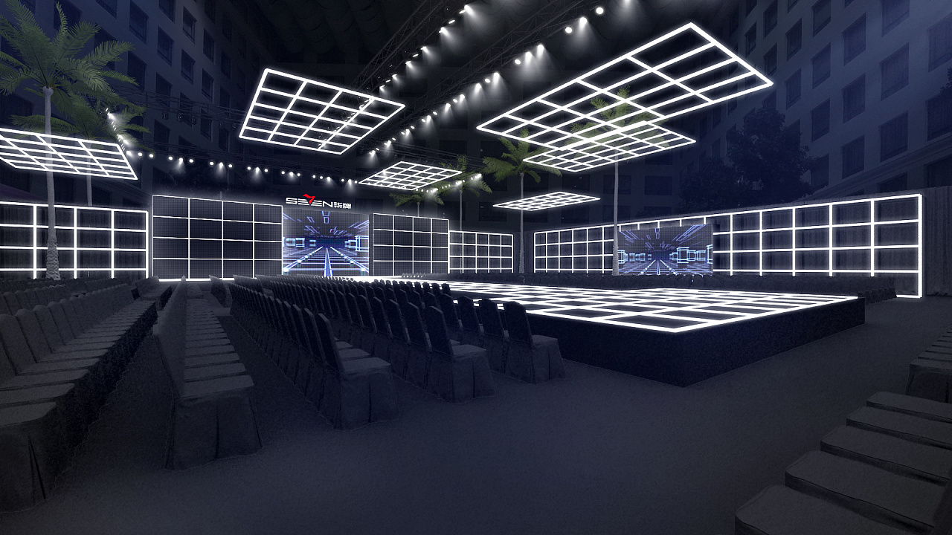
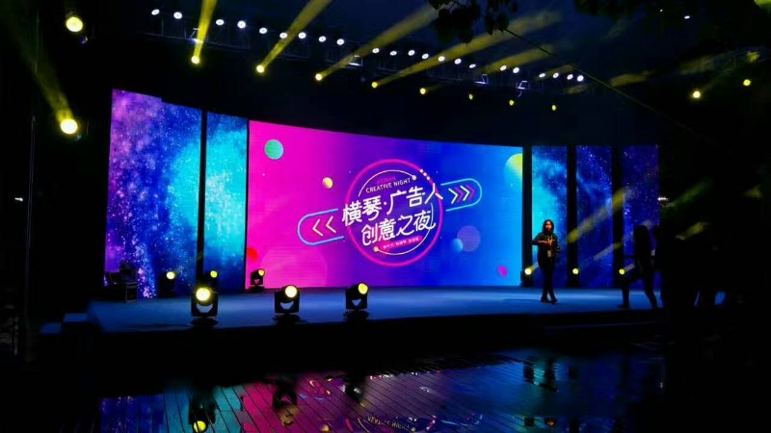
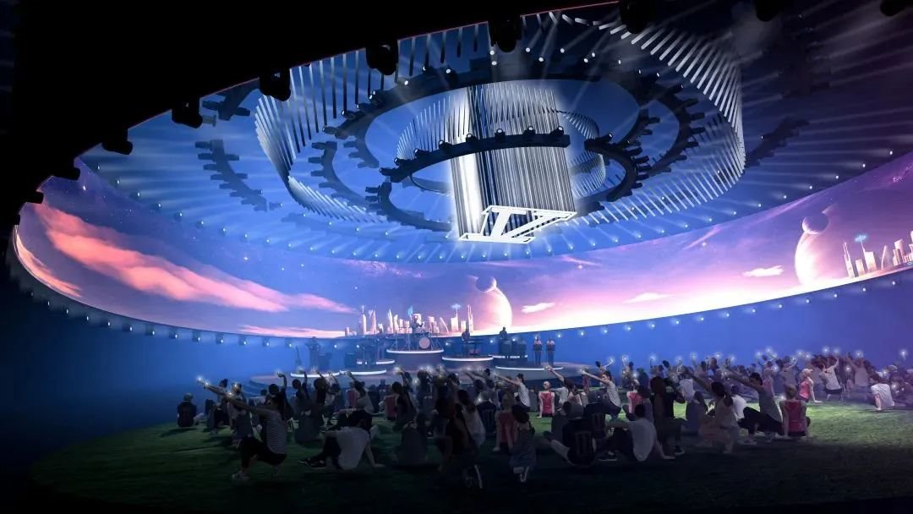
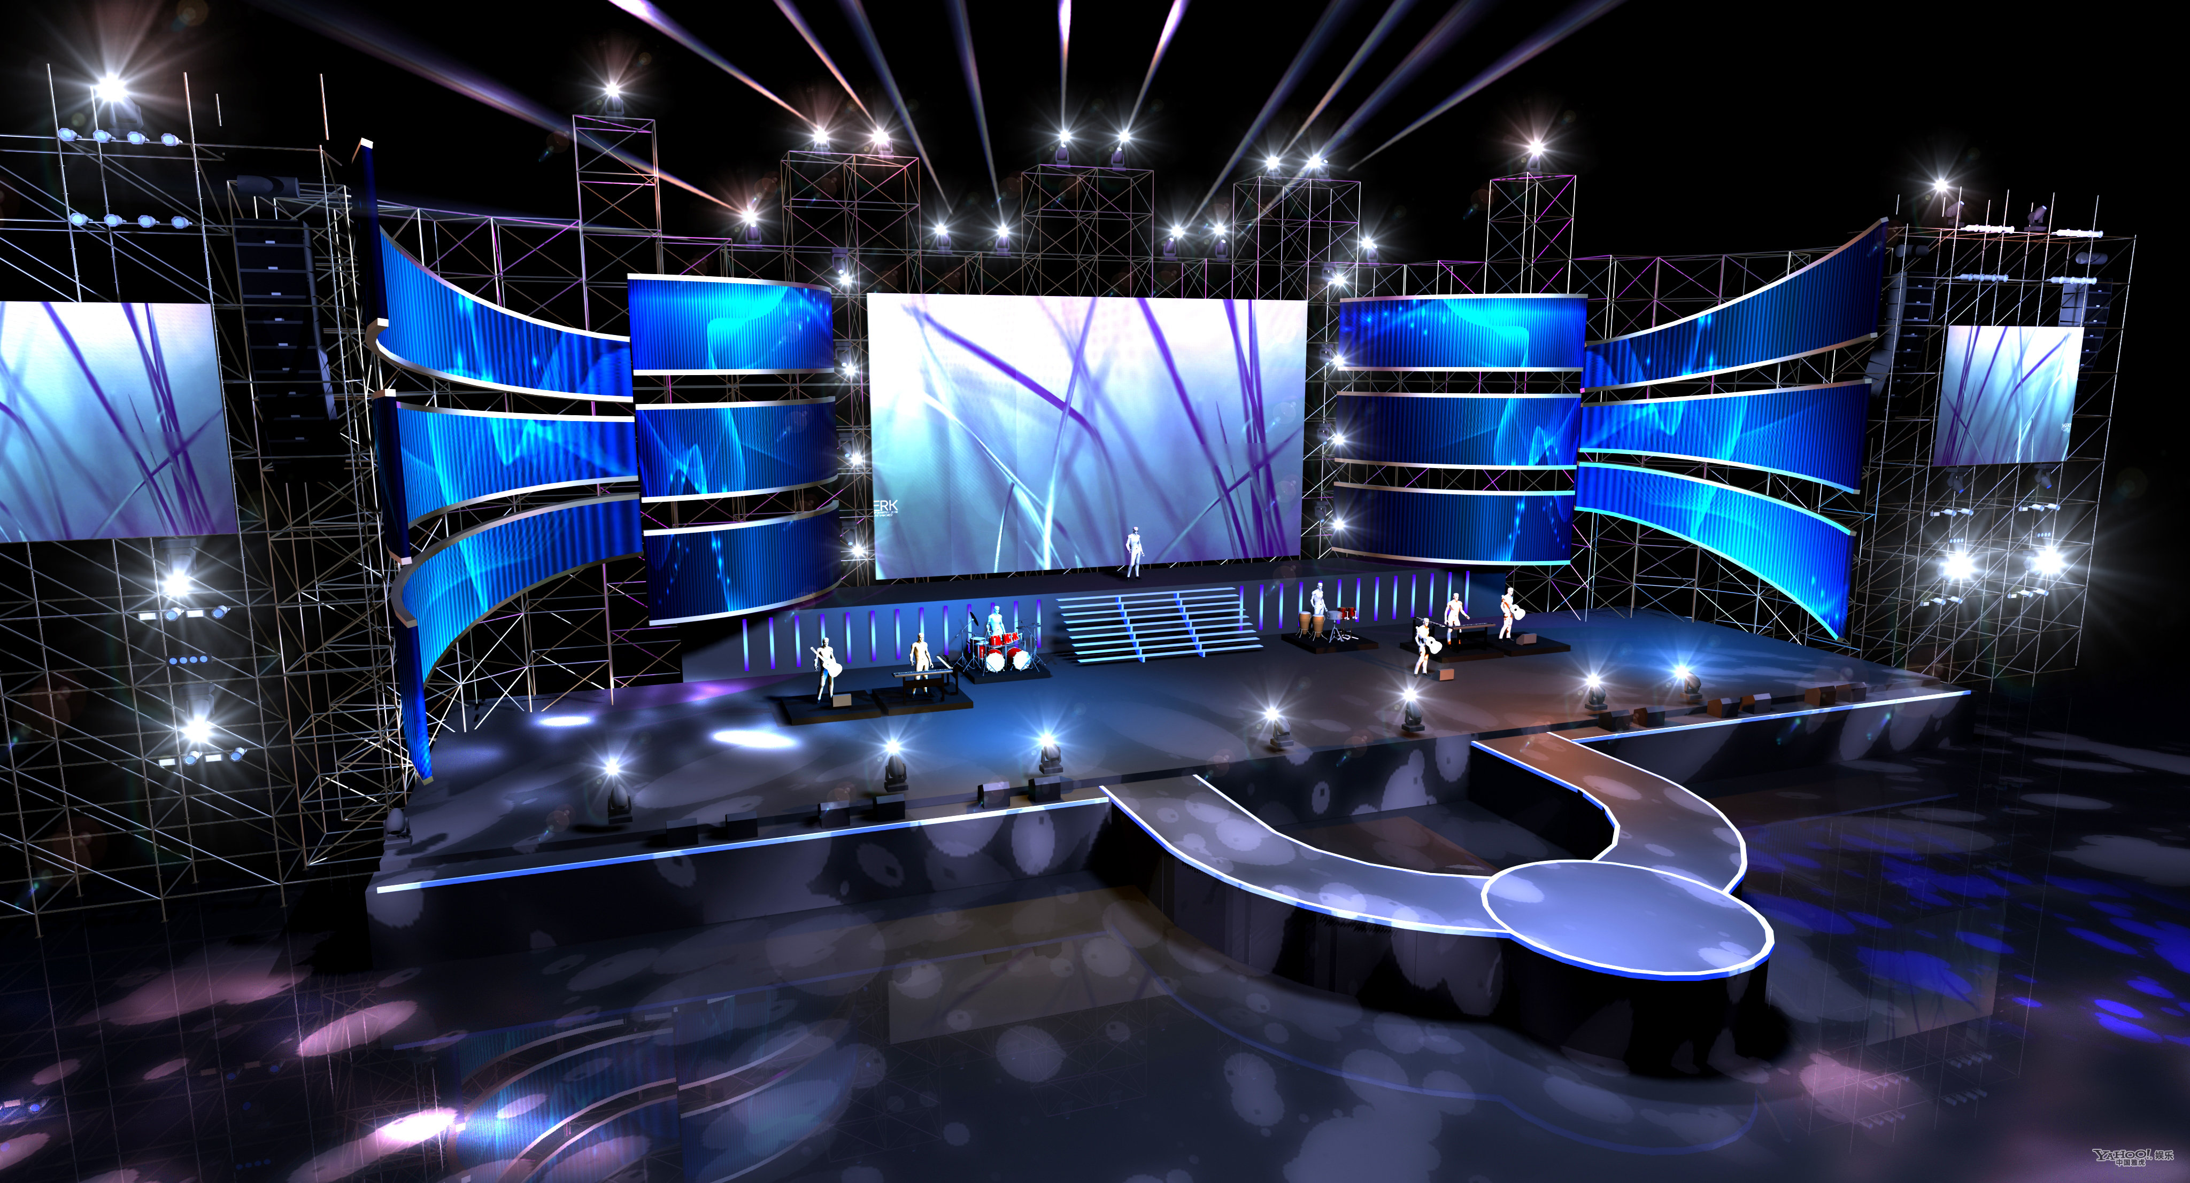
Stage LED Case Pictures
1
2
3
4

Slide 16
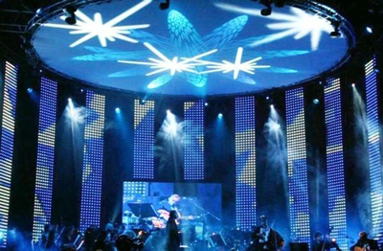
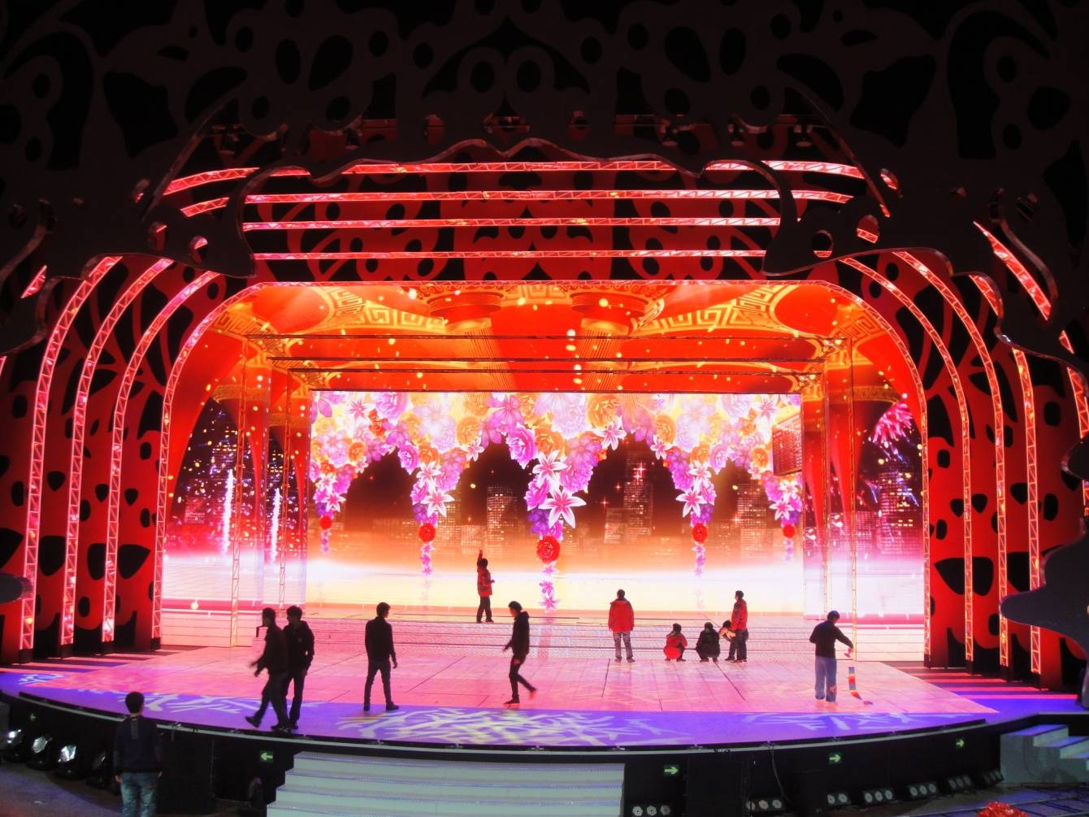
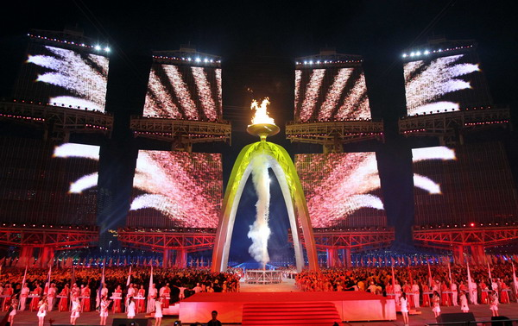
Stage LED Case Pictures
5
6
New Commercial Display-
Dancing and Performing Arts
1. Nanjing Square Stage in 2020.
2. Malysia Music Scene in 2014.
3. Large-scale Event in Singapore in 2013.
4. 50sqm outdoor stage LED in 2021.
5. Korea Music Stage in 2013.
6. Tianjing Theater in 2019.
7. 200sqm New York Live Theater in 2014.
7

Slide 17
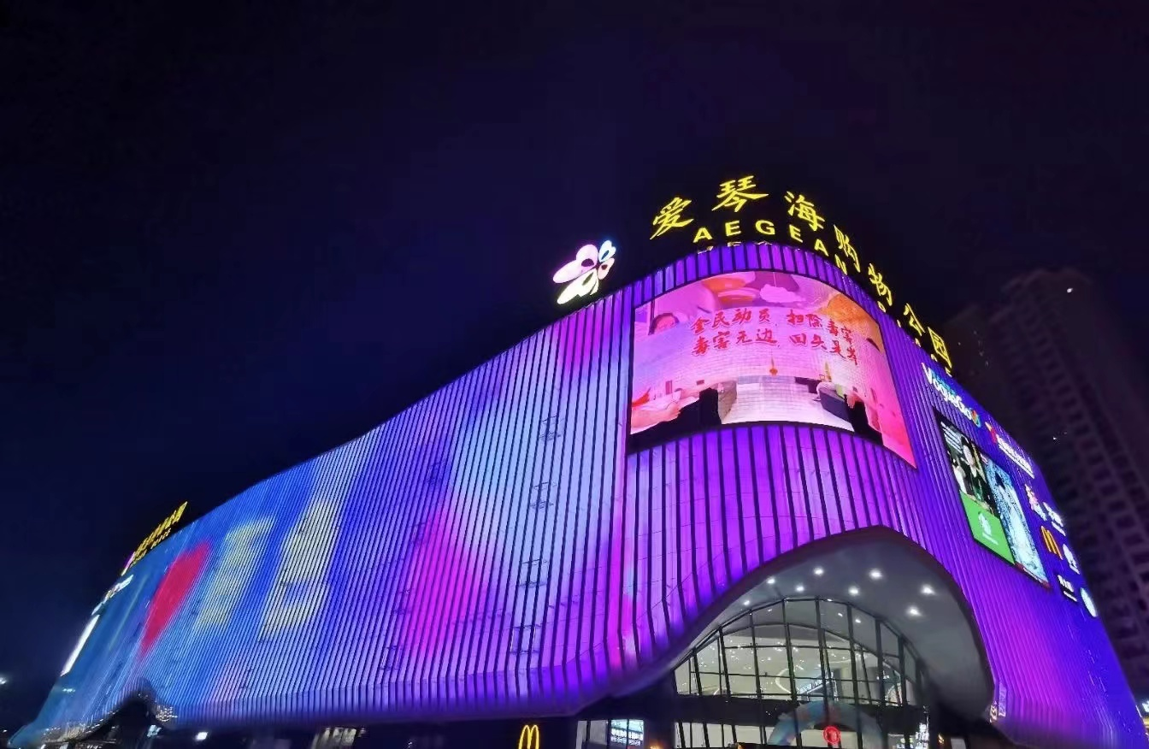
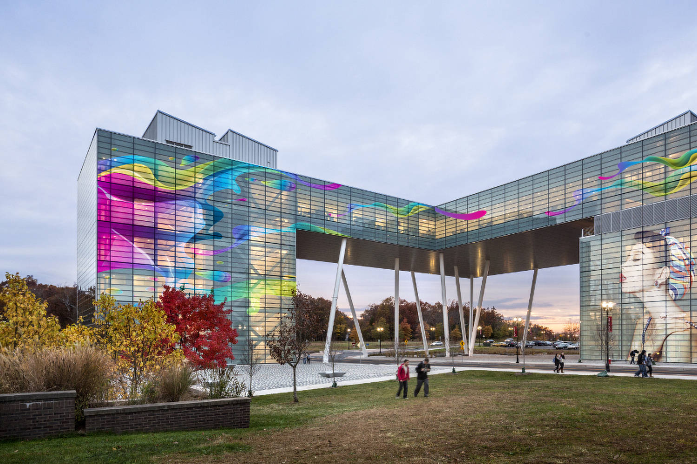
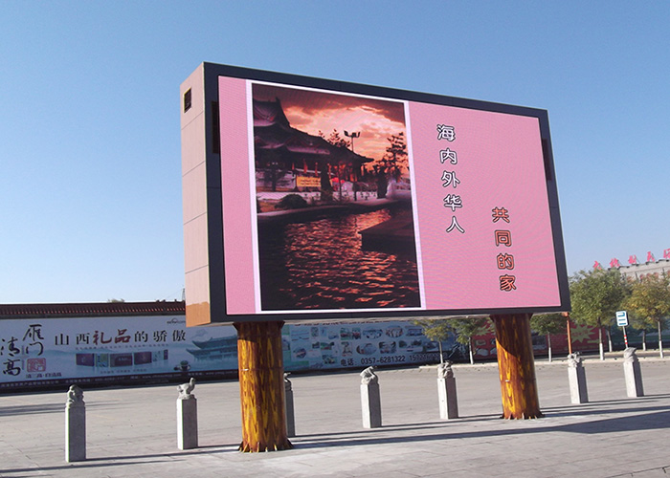
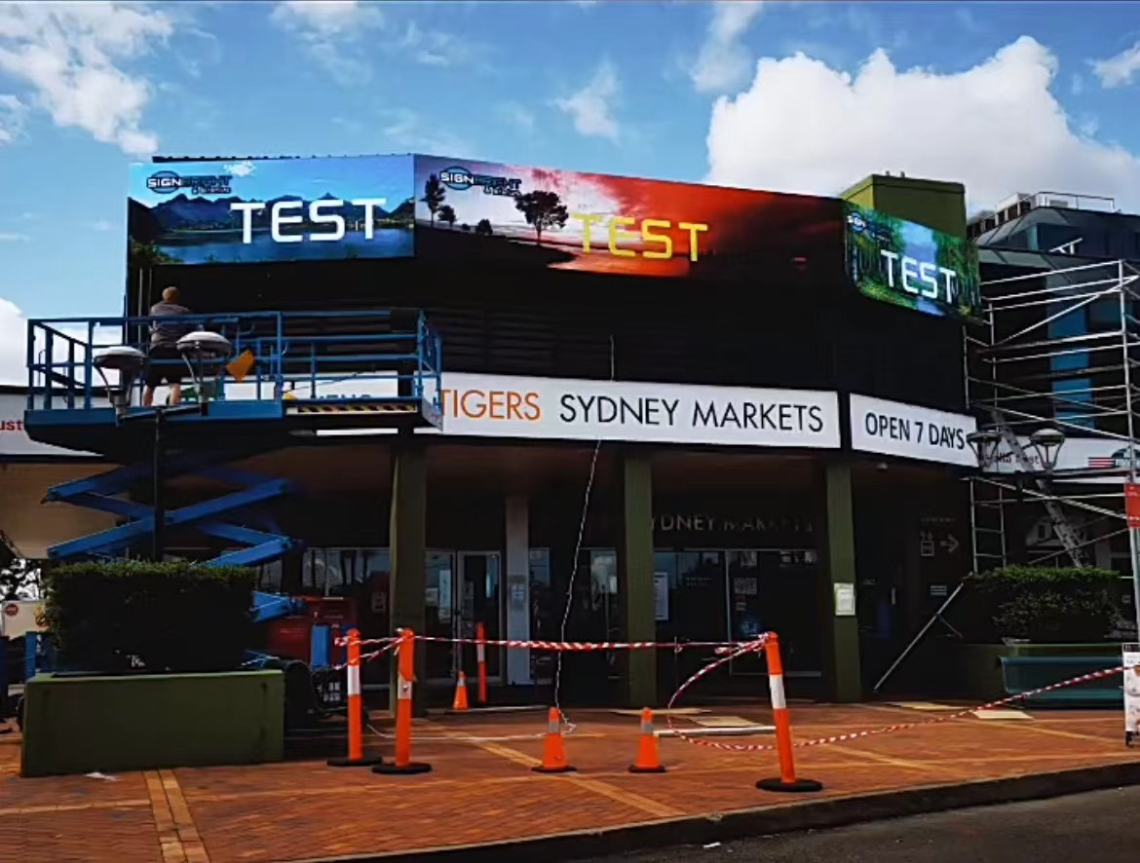
Outdoor LED Display for Square
1
2
3
4

Slide 18
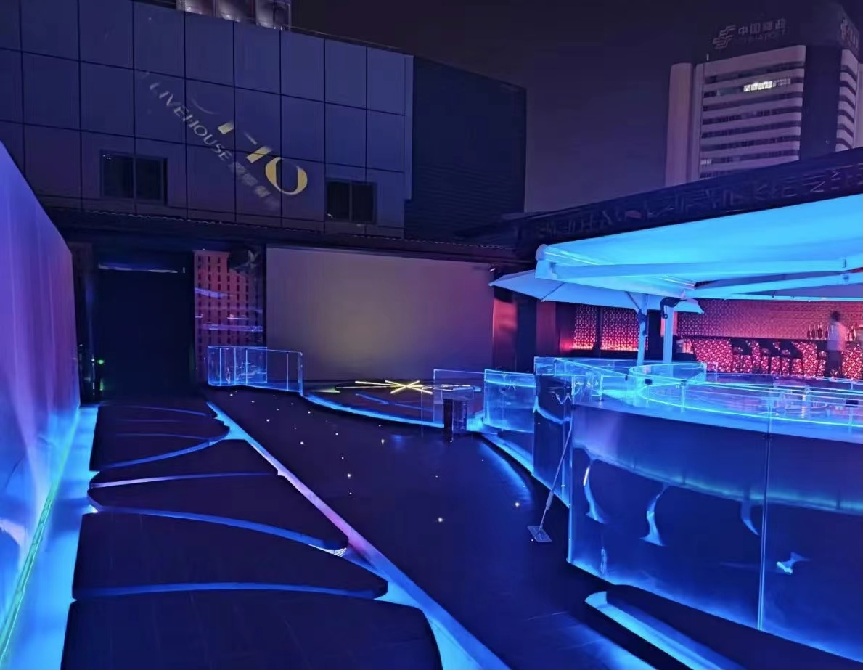
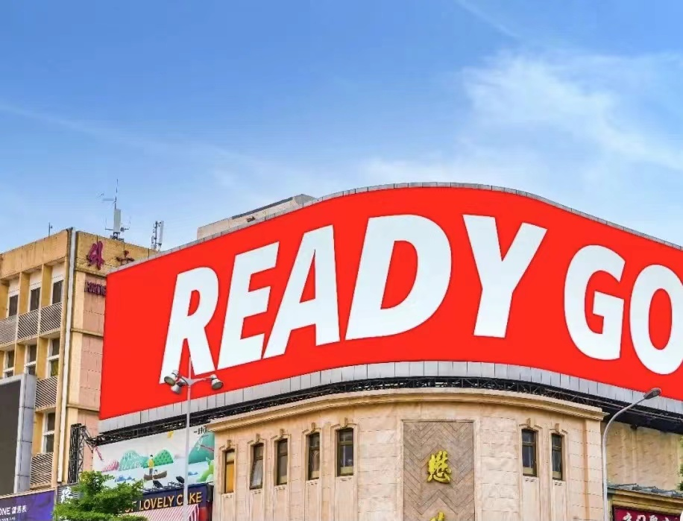
Billboard LED Display for Square
5
6
New business Display-
Outdoor Advertising
1. Macao Shopping Mall in 2012.
2. 165sqm of Outdoor Transparent LED in Hunan.
3. P8 Outdoor Billboard for Hongkong
4. P4 Outdoor Advertising LED in Sydney
5. P6 billboard of shopping mall in Anhui province
6. 83sqm Night Club LED Display
7. Commercial district in Vietnam.
7

Slide 19
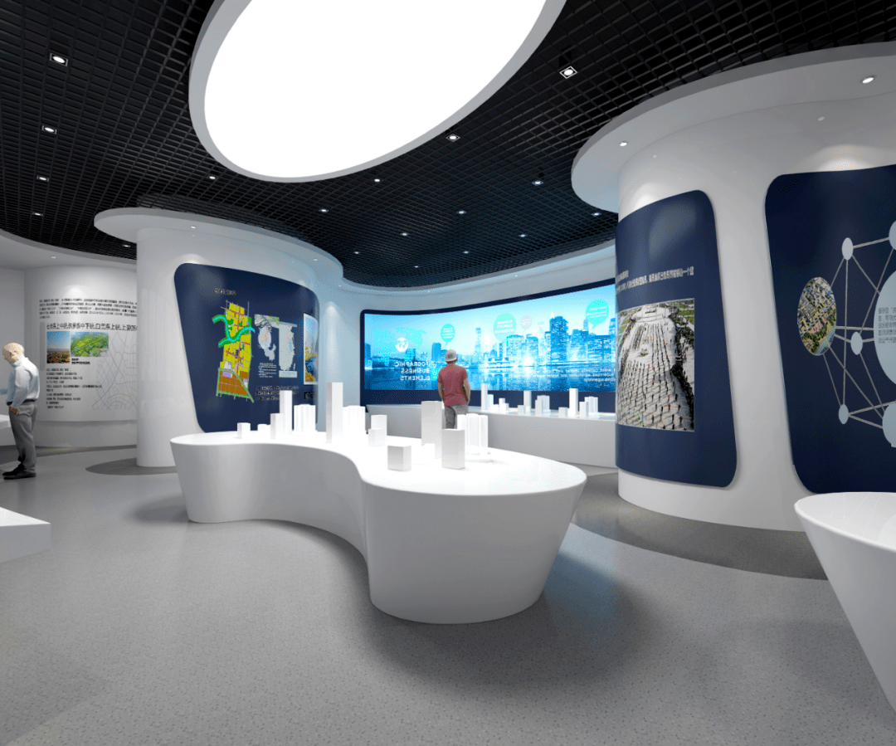
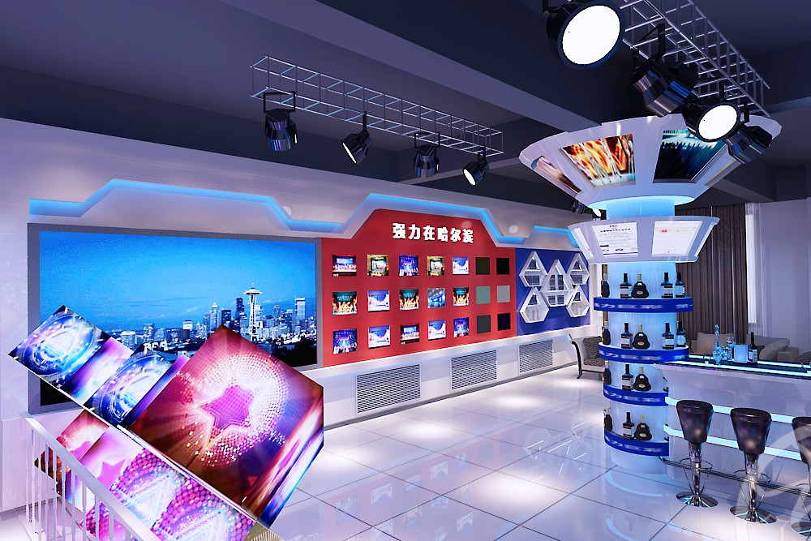
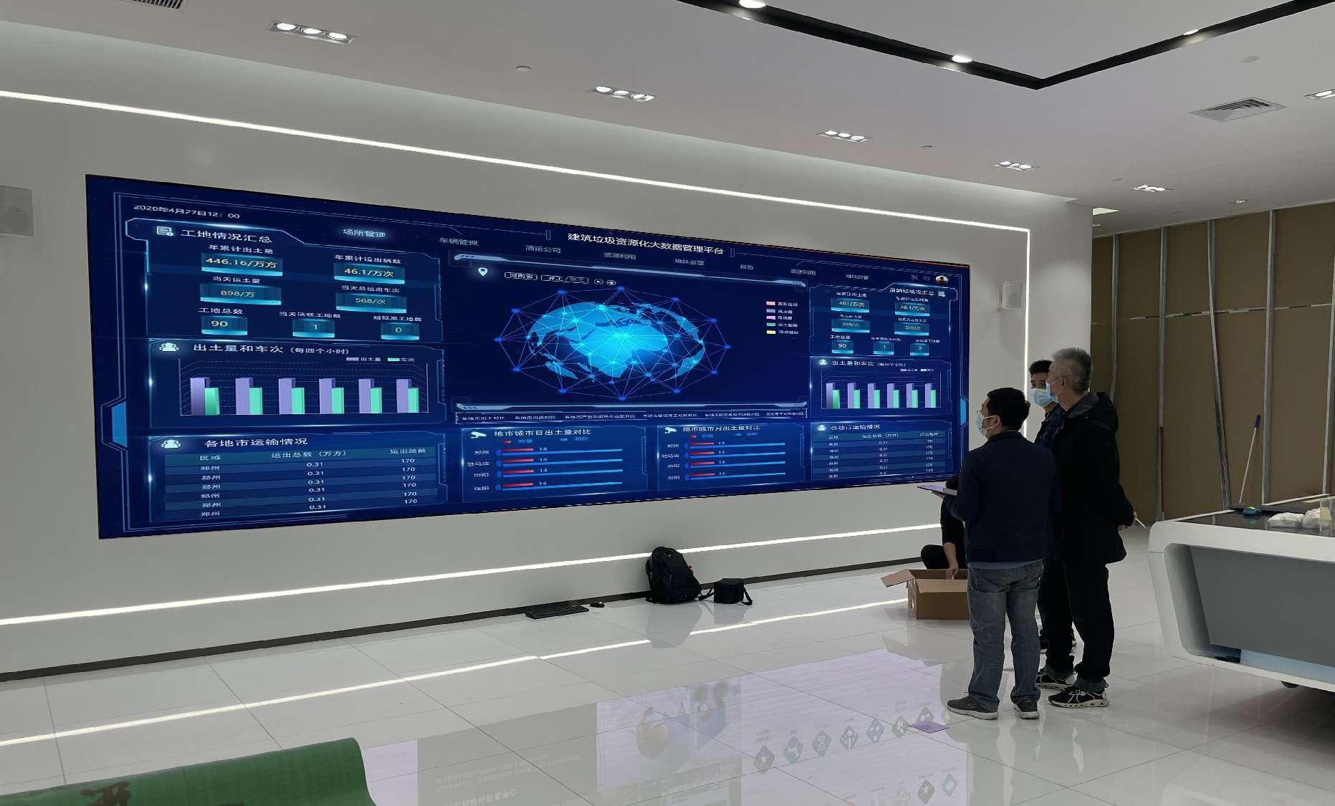
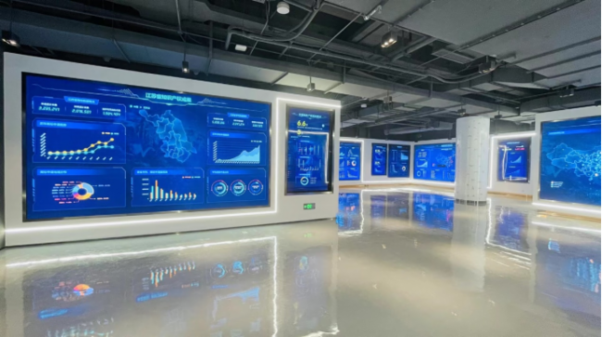
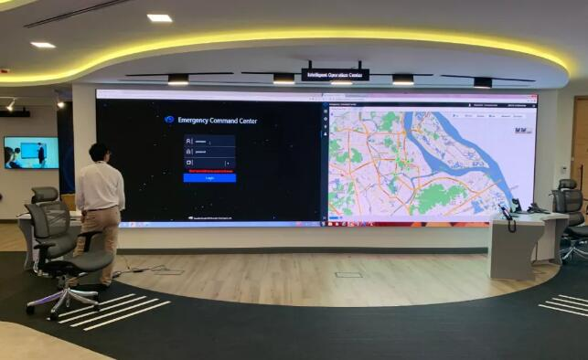
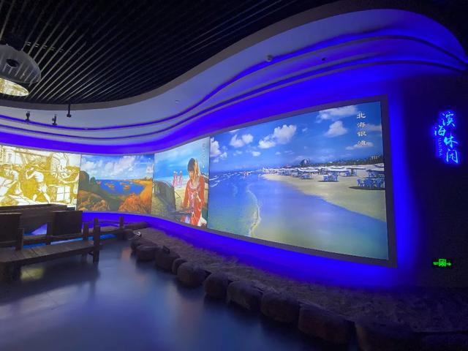
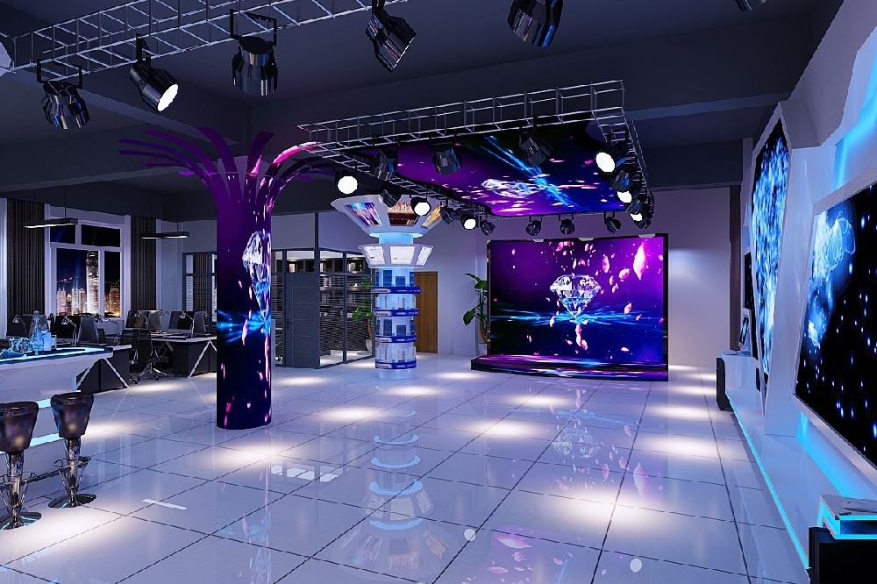
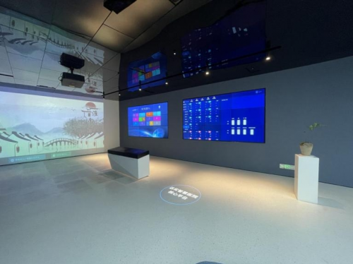
New Commercial High-End LED Display

Slide 20
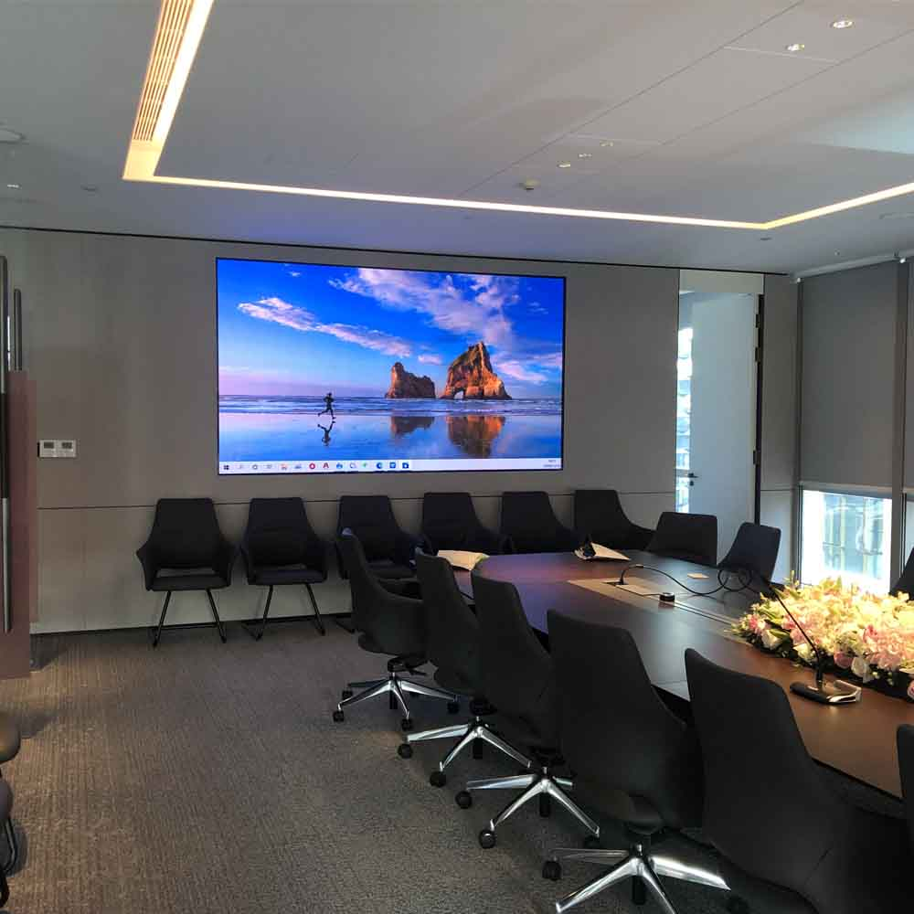
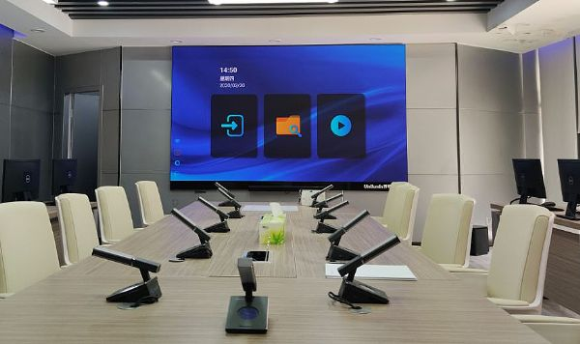
Artificial Intelligence Conference Equipment

Slide 21
Flexible LED DIY Case pictures

